Slide 1


Price prediction for Airbnb
26th April 2024

Slide 2

Background and Overview
Offers unique & affordable accommodation for corporate and leisure requirements
Revolutionized Travel & Hospitality Industry in 220+ countries
Has more than 150 million worldwide users that have booked over 1.5 billion stays
5M+ hosts worldwide with 7.7M+ listings

Slide 3
Business Problem
Accurate pricing is crucial for attracting guests & maximizing the earnings for the hosts as well as Airbnb against its competitors.​
Analyzing the data for Airbnb listings in the United States
Predicting the price based on various features and reviews
Accurate estimations to benefit hosts and the service provider
How are we solving it?

Slide 4





Data
Collection
Data Preparation
Detect outliers, Identify target and features, Split the data into training and test data.
Exploratory Data Analysis
Descriptive Analysis (Mean of Actual Price)
Model Building
Neural Network Regression
Random Forest Regression
Linear Regression
Model Evaluation
MAE
MSE
RMSE
R²

Slide 5
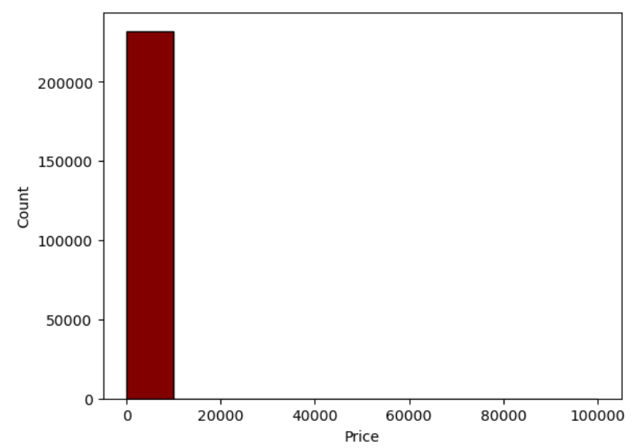
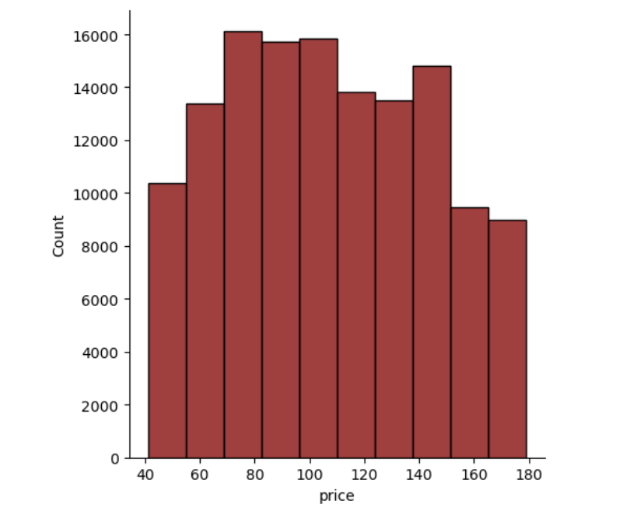
Feature Engineering
FEATURES
Name and Amenities
Room Type
Price
Minimum Nights
Number of Reviews
Reviews
Availability in 1 Year
City
Latitude
Longitude
Factors | Stats
No. of features | 18
No. of instances | 858.10 trillion
No. of selected features | 10
Target Variable | Price

Slide 6
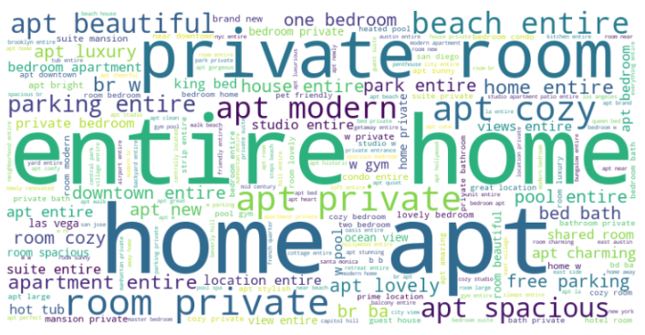
Words extracted using Natural Language Processing

Slide 7
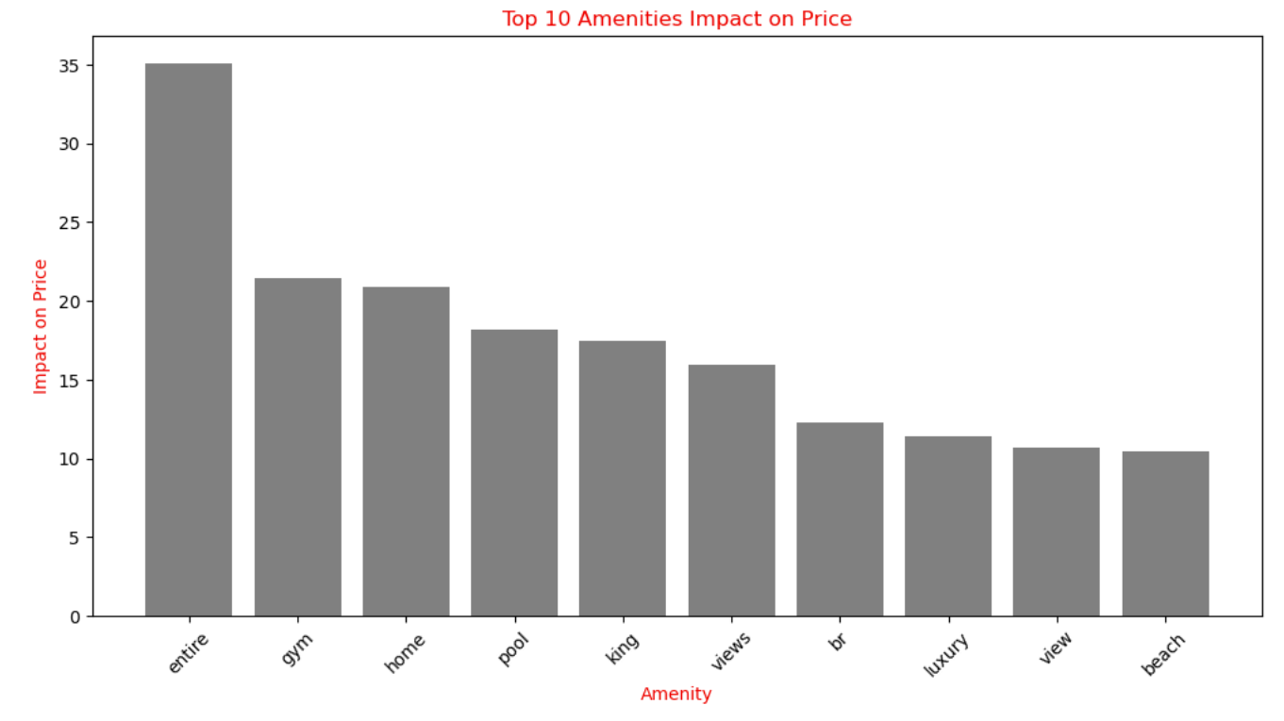
Most affecting factors on Price
Legend: Entire - Entire Apartment
King - King Size Bed
Br - Individual bedroom
The important amenities impacting the price of Airbnb properties are Entire Apt, Gym, Home, Pool, Views and Beach.

Slide 8
Model Validation
Metrics
Based on these metrics, the Random Forest Regression model appears to perform the best overall, with the lowest MAE, MSE, and RMSE, as well as the highest R-squared value.

Slide 9

Business Suggestions
Highlight Amenities through pictures in your listings and consider investing on improving them.
Market Segmentation for targeted marketing based on features.
Competitive positioning in the market based on price and location.
Feedback Loop from guests to validate the importance of amenities in your property and monitor guest satisfaction.

Slide 10

Future Scope
Optimize Random Forest through hyperparameter tuning.
Address overfitting in Neural Network model.
Evaluate alternative regression algorithms for comparison.
Enhance models through feature engineering techniques.

Slide 11
Thank you
Guide: Prof. Yue Gao
Team: Gobind Uttamkumar
Trishali Yogesh Rao
Shubham Gosavi
Deepthi Sri Kunapareddi

